Slide 1

UE20CS302 – Machine Intelligence
Mini Project
Traffic Sign Classification
Team No: 4
Project Guide : Dr. Alpha Vijayan
Project Team with SRNs :
Shuvam Bose PES2UG20CS335
Siddhant Pathak PES2UG20CS337
V Bavanika PES2UG20CS374

Slide 2
Problem Statement
Traffic Sign classifier is very crucial in the current era of self-driving and autonomous cars. Due to high-speed movement of vehicles and criticality of the situation, recognition and classification accuracy is particularly important.
This problem has two aspects, first is feature extraction i.e., extracting relevant features from the traffic sign images and second is image classification, which includes classification of an image to its corresponding class based on the extracted features.
Identification of the traffic and taking appropriate action is crucial for an automated vehicle. This system will assist drivers by recognizing traffic signs which they did not recognize before passing and will save them from miss happenings.
To solve this problem, we are using Deep Learning, specifically Convolutional Neural Network (CNN).

Slide 3
Application and Uses
Can be used in autonomous vehicles.
Help the driver to recognise the traffic sign under abnormal conditions. For example if the driver is new to the place (let's say some foreign country) where he/she wants to drive, but is unaware of the traffic signs in that country.
It can also be used under extreme weather conditions. For example, it’s very hard to see the traffic signs on the road at the time of heavy rainfall. At those times traffic sign classifier plays a significant role.

Slide 4
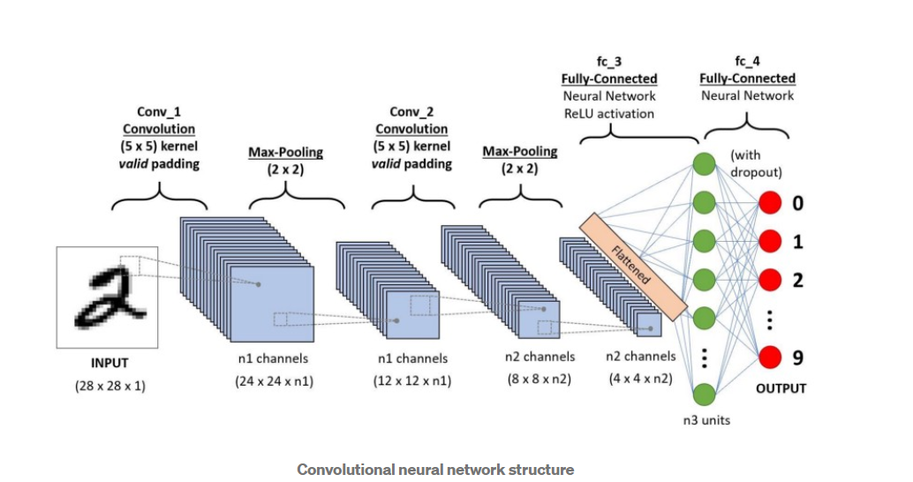
High level Architecture

Slide 5
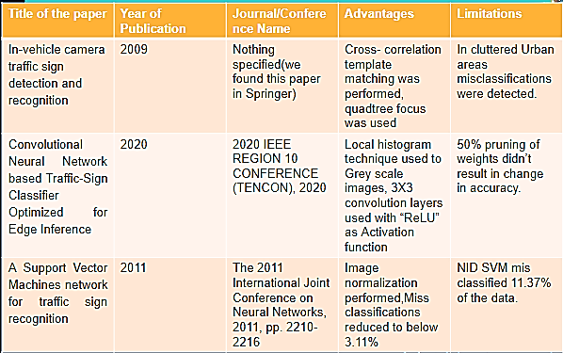
Literature Survey

Slide 6
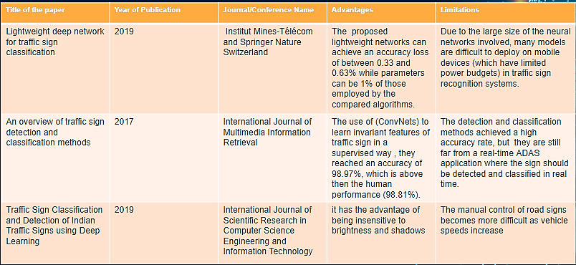
Literature Survey

Slide 7
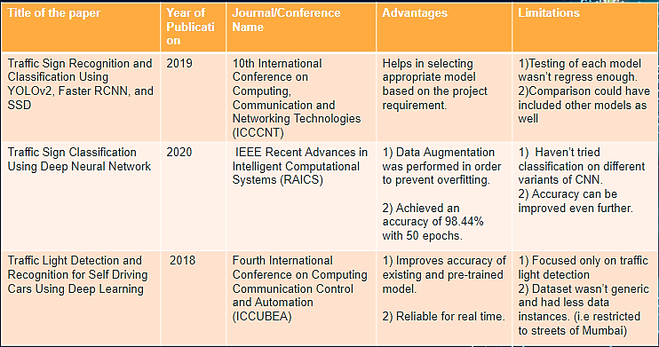
Literature Survey

Slide 8
Proposed Approach
We have planned to develop a software with basic front end using Python GUI library-Tkinter.
We have used many convolution layers with dense layers and dropdowns to get desired results(i.e. Accuracy of 95+%).
The user uploads an image containing German traffic sign into the front end for the trained model to classify it amongst the predetermined classes only.
The model is expected to classify the image 98 % of the time correctly as we have trained out model for 15 epochs to obtain the results.

Slide 9
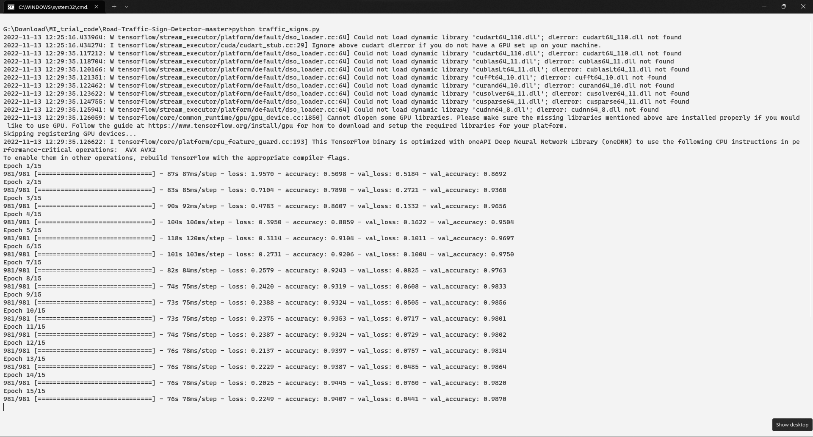
Results and Discussion
CMD output while training model

Slide 10
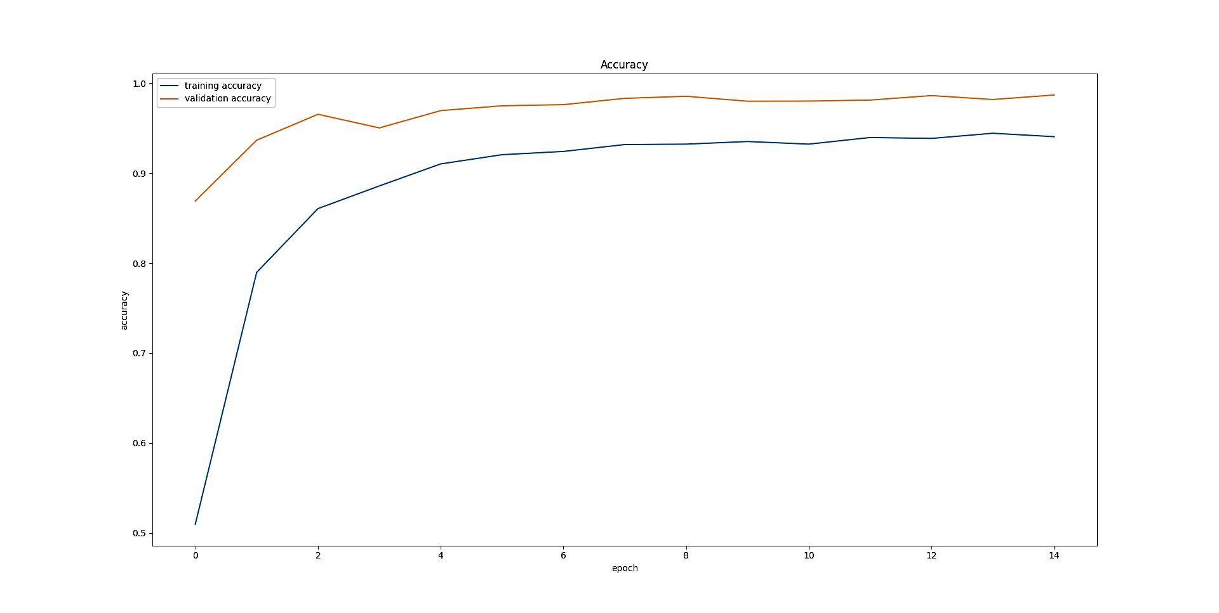
Results and Discussion
Plotted while testing the model:(Accuracy Vs Epoch)

Slide 11
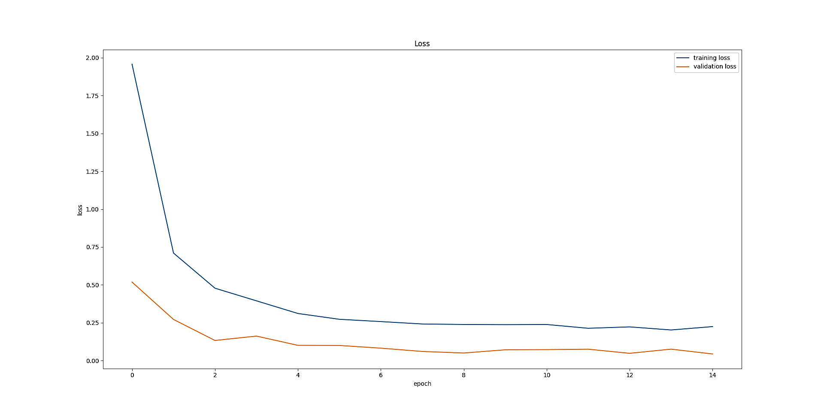
Results and Discussion
Plotted while testing the model:(Loss Vs Epoch)

Slide 12
Conclusion
We have successfully implemented and demonstrated our project and it capabilities.
The project has been completed with good will and we are very thankful to our Professor and PES University for continuous guidance and support throughout the project.
We have tested our model thoroughly and concluded that it can predict 98% of the time correctly provided the traffic sign belongs to german data set. If not the model still classifies but not with the abovementioned accuracy.
The future scope is to implement the same using openCV library that would enable it to give live predictions with more accuracy.

Slide 13
References
[1] Ruta, A., Porikli, F., Watanabe, S. et al. In-vehicle camera traffic sign detection and recognition. Machine Vision and Applications 22, 359–375 (2011). https://doi.org/10.1007/s00138-009-0231-x
[2] B. B. Shabarinath and P. Muralidhar, "Convolutional Neural Network based Traffic-Sign Classifier Optimized for Edge Inference," 2020 IEEE REGION 10 CONFERENCE (TENCON), 2020, pp. 420-425, DOI: 10.1109/TENCON50793.2020.9293767.
[3] F. Boi and L. Gagliardini, "A Support Vector Machines network for traffic sign recognition," The 2011 International Joint Conference on Neural Networks, 2011, pp. 2210- 2216, doi: 10.1109/IJCNN.2011.6033503.
[4] P. Garg, D. R. Chowdhury and V. N. More, "Traffic Sign Recognition and Classification Using YOLOv2, Faster RCNN and SSD," 2019 10th International Conference on Computing, Communication and Networking Technologies (ICCCNT), 2019, pp. 1-5, doi: 10.1109/ICCCNT45670.2019.8944491.
[5] M. A. Vincent, V. K. R and S. P. Mathew, "Traffic Sign Classification Using Deep Neural Network," 2020 IEEE Recent Advances in Intelligent Computational Systems (RAICS), 2020, pp. 13-17, doi: 10.1109/RAICS51191.2020.9332474.
[6] R. Kulkarni, S. Dhavalikar and S. Bangar, "Traffic Light Detection and Recognition for Self Driving Cars Using Deep Learning," 2018 Fourth International Conference on Computing Communication Control and Automation (ICCUBEA), 2018, pp. 1-4, doi: 10.1109/ICCUBEA.2018.8697819.
[7] Lightweight deep network for traffic sign classification Jianming Zhang1,2 & Wei Wang1,2 & Chaoquan Lu1,2 & Jin Wang1,2 & Arun Kumar Sangaiah3 Received: 15 December 2018 /Accepted: 18 July 2019 # Institut Mines-Télécom and Springer Nature Switzerland AG 2019
[8] Saadna, Y., & Behloul, A. (2017). An overview of traffic sign detection and classification methods. International Journal of Multimedia Information Retrieval, 6(3), 193–210. doi:10.1007/s13735-017-0129-8
[9] Traffic Sign Classification and Detection of Indian Traffic Signs using Deep Learning Manjiri Bichkar, Suyasha Bobhate, Prof. Sonal Chaudhari, doi: https://doi.org/10.32628/CSEIT217325 215

Slide 14
Thank You

